Slide 1
Changes to be made (part 2)

Slide 2
Daily Bar Operations (DDS)

Slide 3
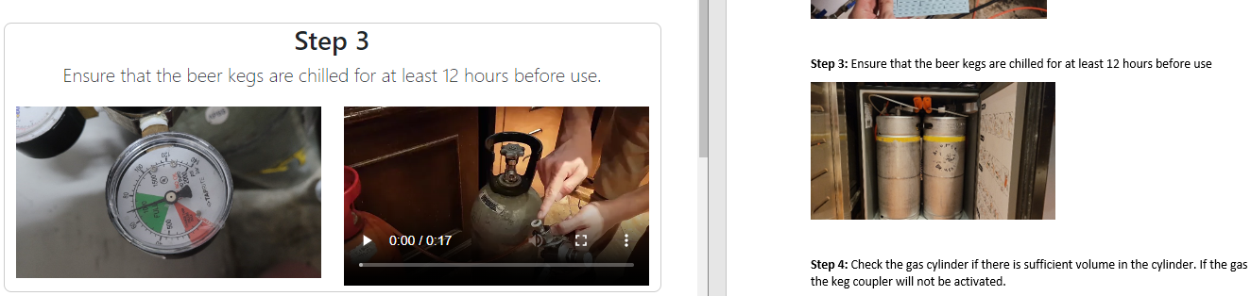
Daily Bar Operations (DDS) – Step 3
Current
Correct (from the document)
Image first, and insert step below

Slide 4
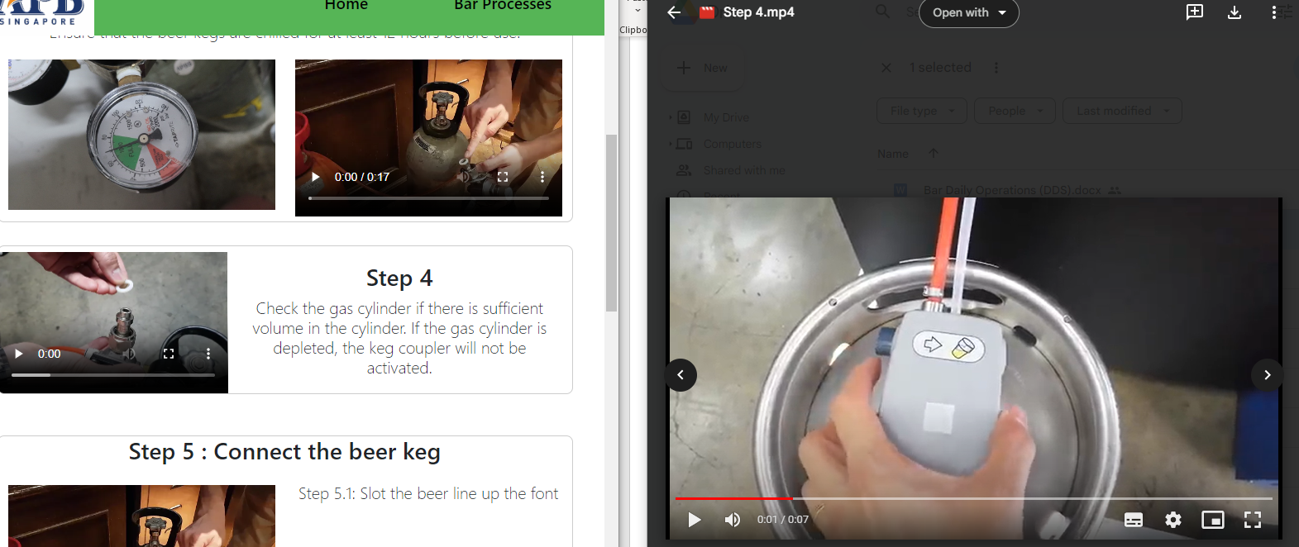
Daily Bar Operations (DDS) – Step 4
Current
Correct (it should be this video instead, labelled step 4)

Slide 5
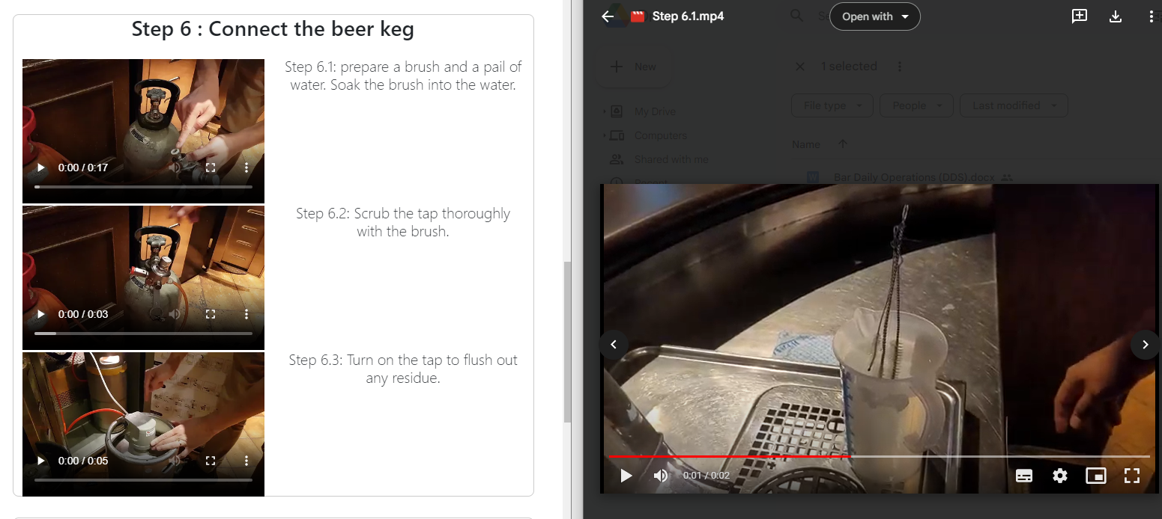
Daily Bar Operations (DDS) – Step 6
Change “Connect the beer keg” to “Clean the beer tap”
Same as step 5, all 3 videos are wrong

Slide 6
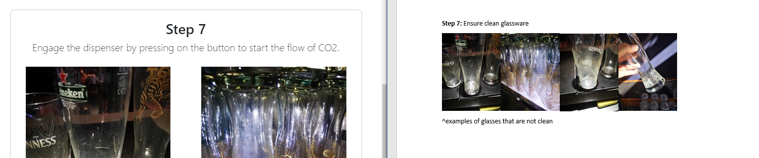
Daily Bar Operations (DDS) – Step 7
Current
Change text to “Ensure clean glassware”

Slide 7
Daily Bar Operations (IBC)

Slide 8
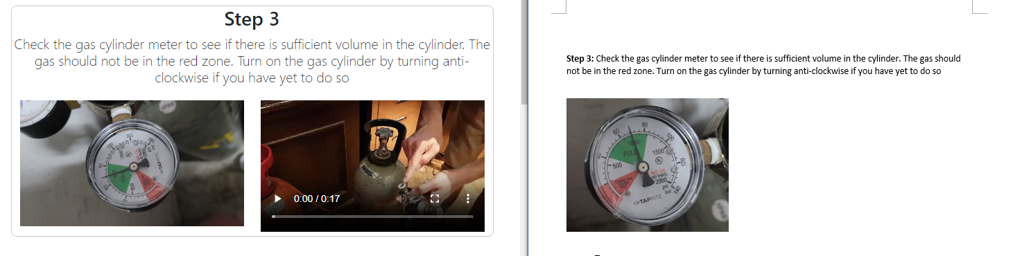
Daily Bar Operations (IBC) – Step 3
Current
Correct (from the document) -> Remove the video and update the image to the one in the document

Slide 9
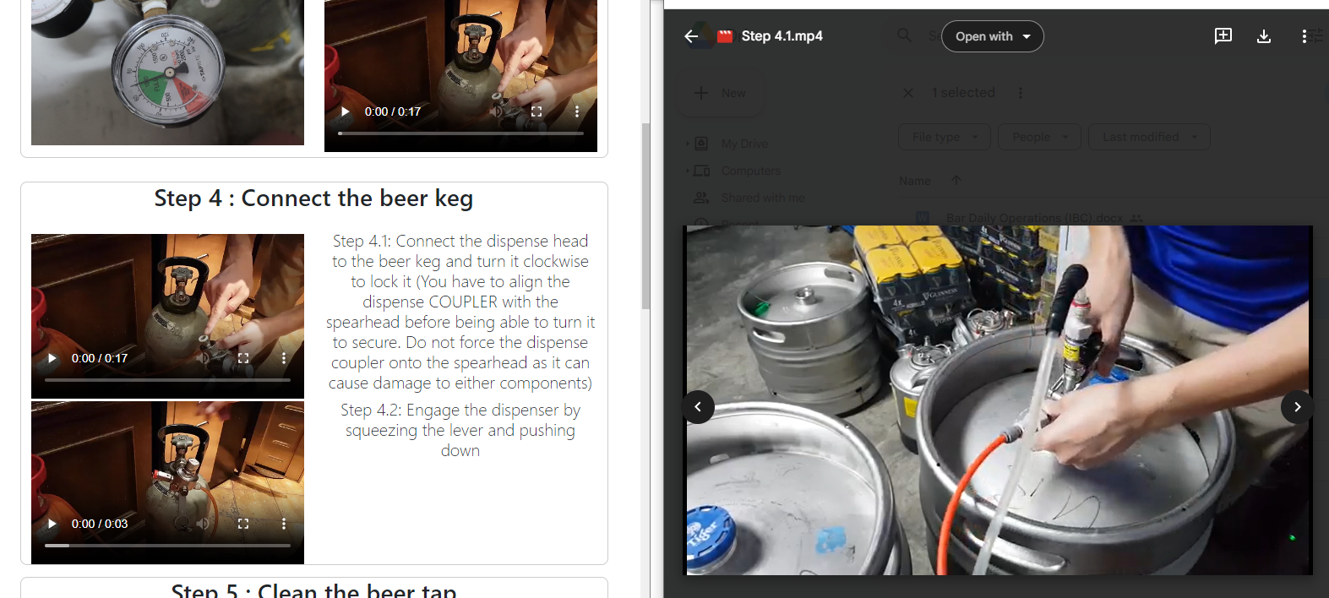
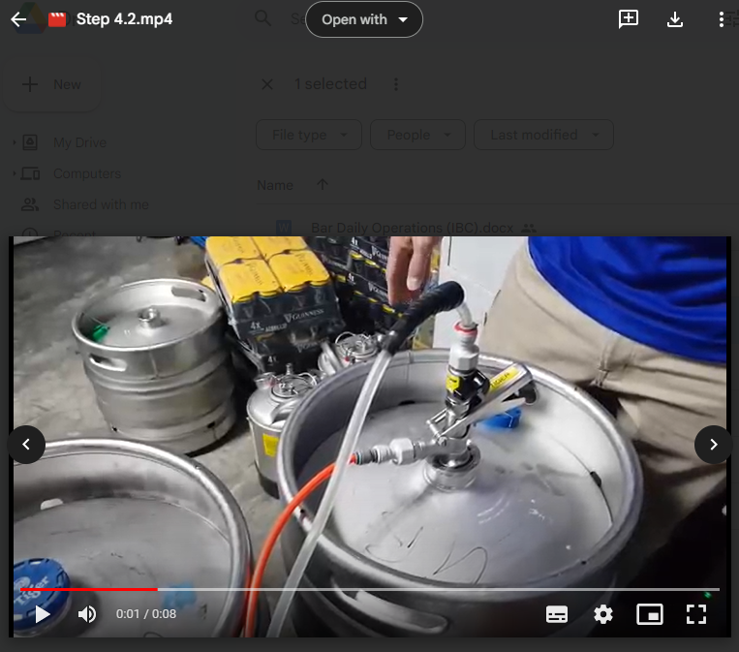
Daily Bar Operations (IBC) – Step 4
Current (the videos for 4.1 and 4.2 are incorrect -> follow the ones inside the google drive)

Slide 10
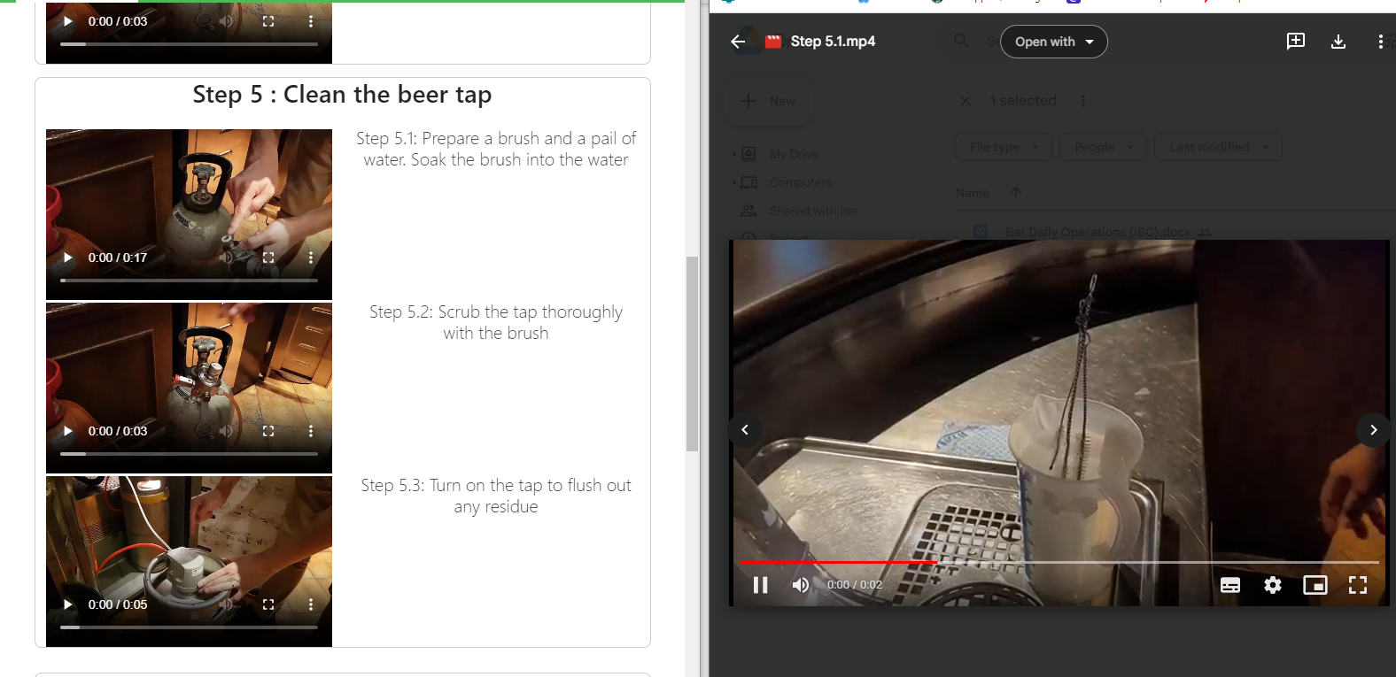
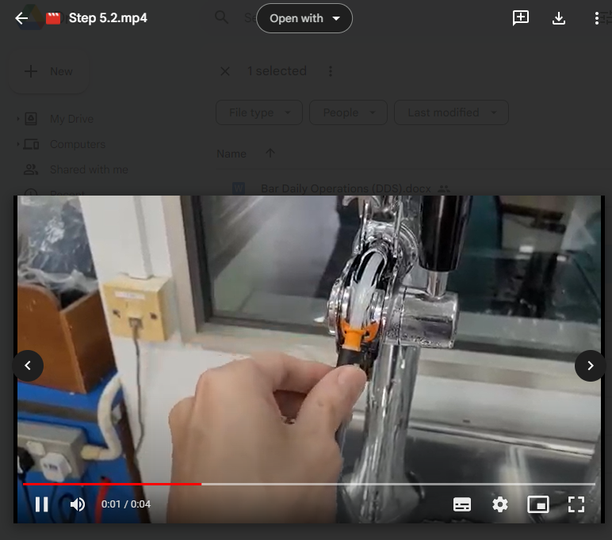
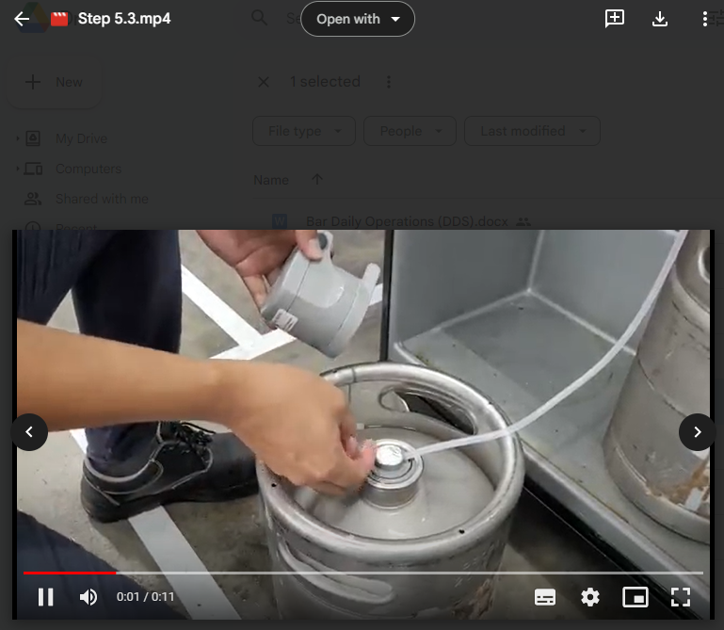
Daily Bar Operations (IBC) – Step 5
Current
Correct (all the 3 videos step 5.1, 5.2, 5.3 are wrong

